Slide 1
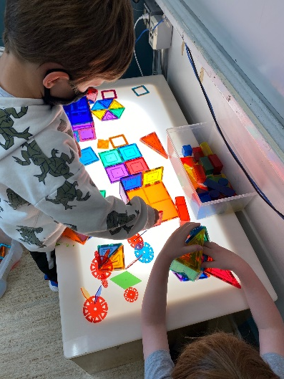
Westgate School Kindergarten/Grade 1 Orientation May 22nd, 2025
Notes:
Welcome and Introductions -

Slide 2


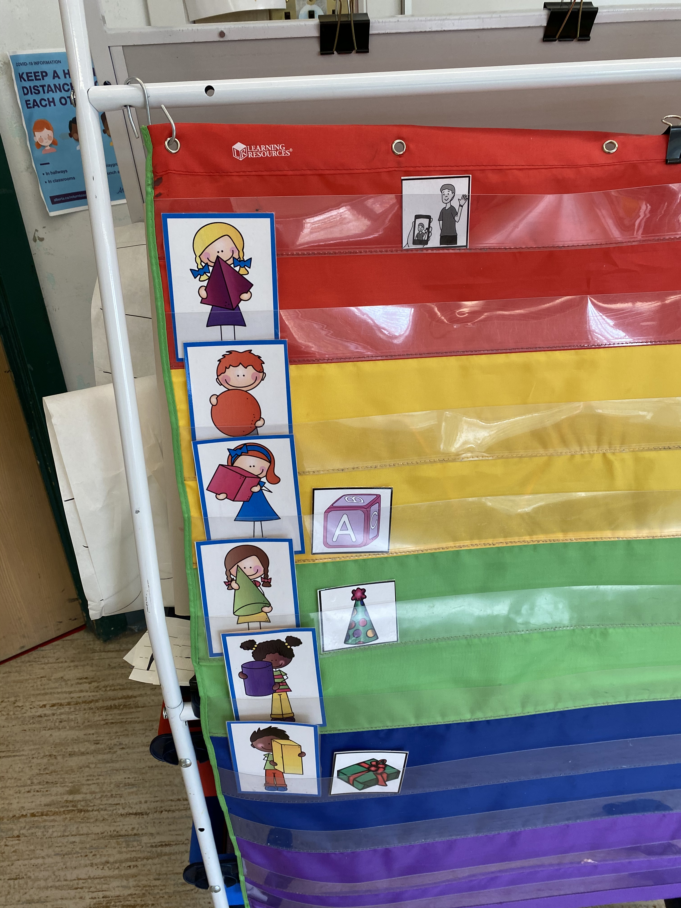
Agenda Welcome and Introduction A Glimpse into Kindergarten School Info / Opening Safety and Security Transportation Communication Volunteering Childcare School Council Questions
Notes:
Julie

Slide 3
French Language Acquisition
Program of Studies - Alberta curriculum
NLA - Neurolinguistic approach to second language learning – research-based pedagogical approach – help build student confidence in communicating in a second language
Executive summary – Impact of Second Language Learning (cognitive, academic, societal, personal, intercultural, economic and for students with learning exceptionalities) See Early French Immersion page on our school website
Francophonie - Providing cultural learning experiences for students to feel a deeper connection to a language
Notes:
Steph

Slide 4
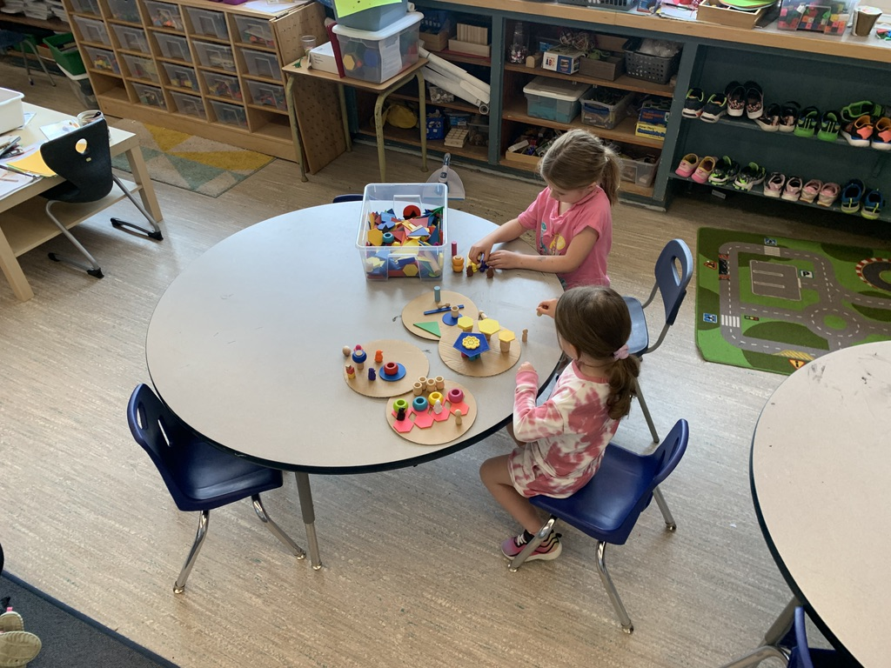
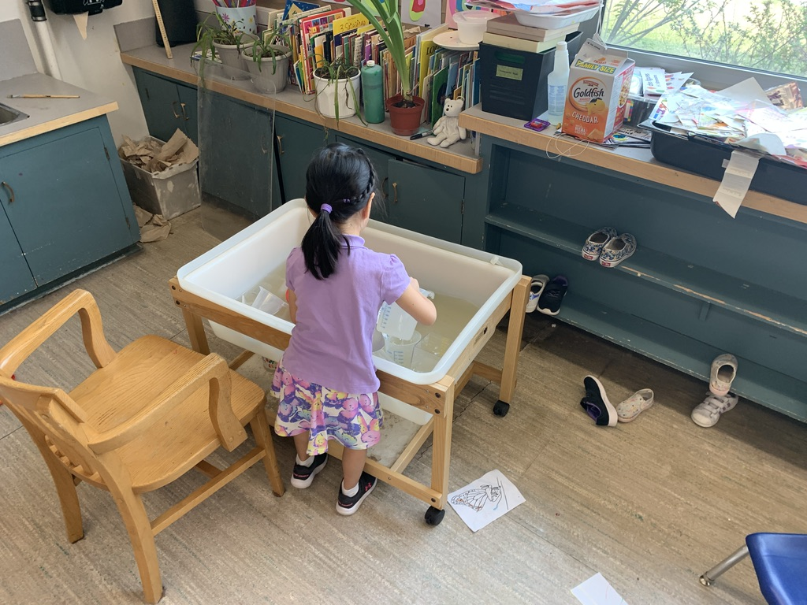
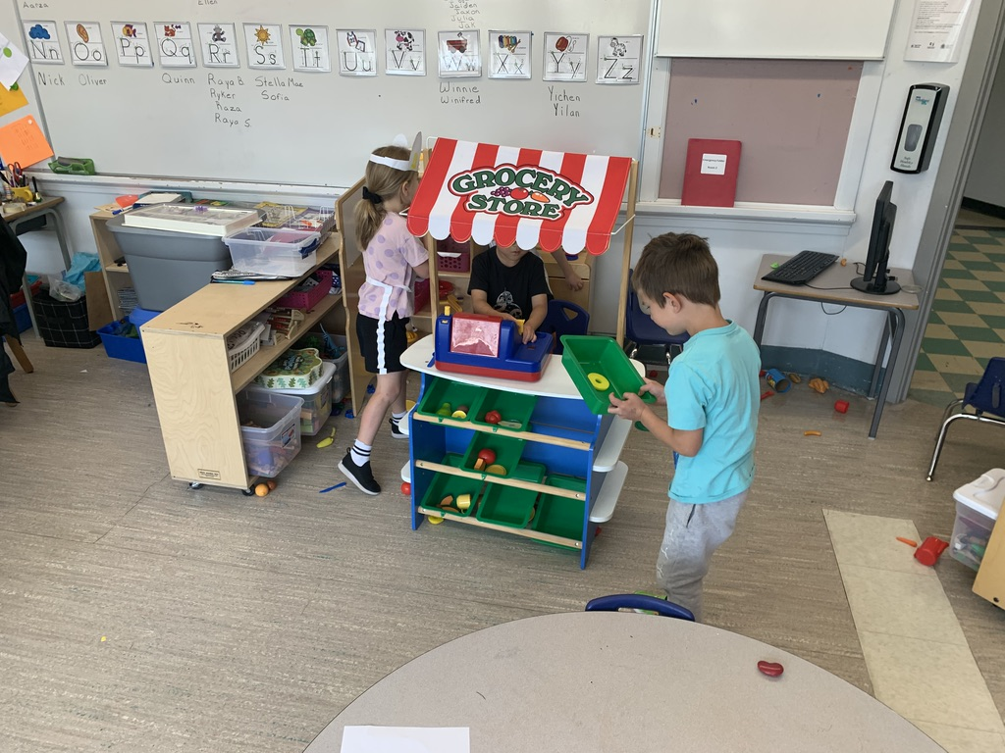
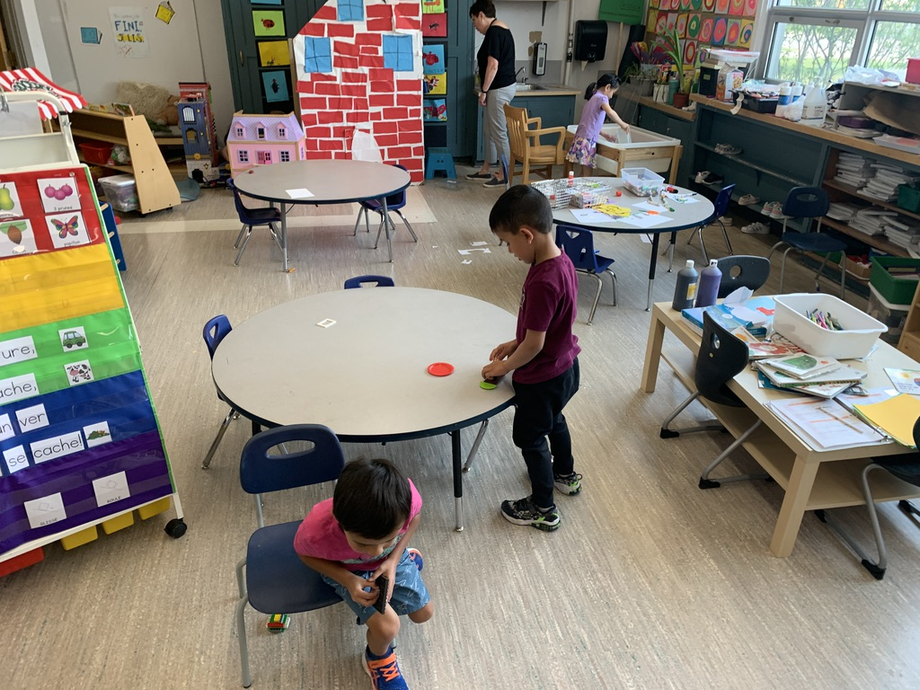
A glimpse inside the kindergarten classroom
Notes:
Steph – to introduce / Jessica to speak to it

Slide 5
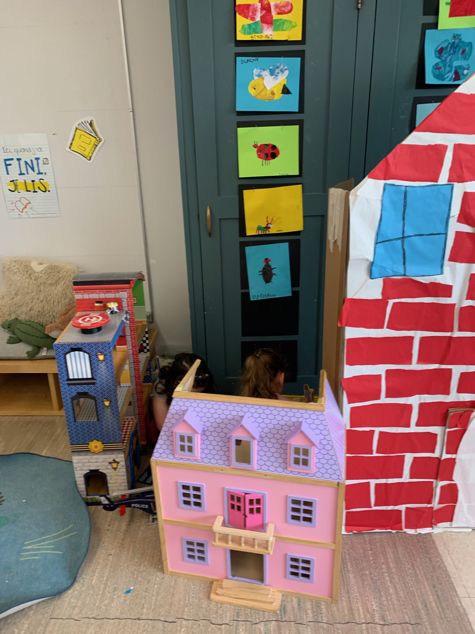
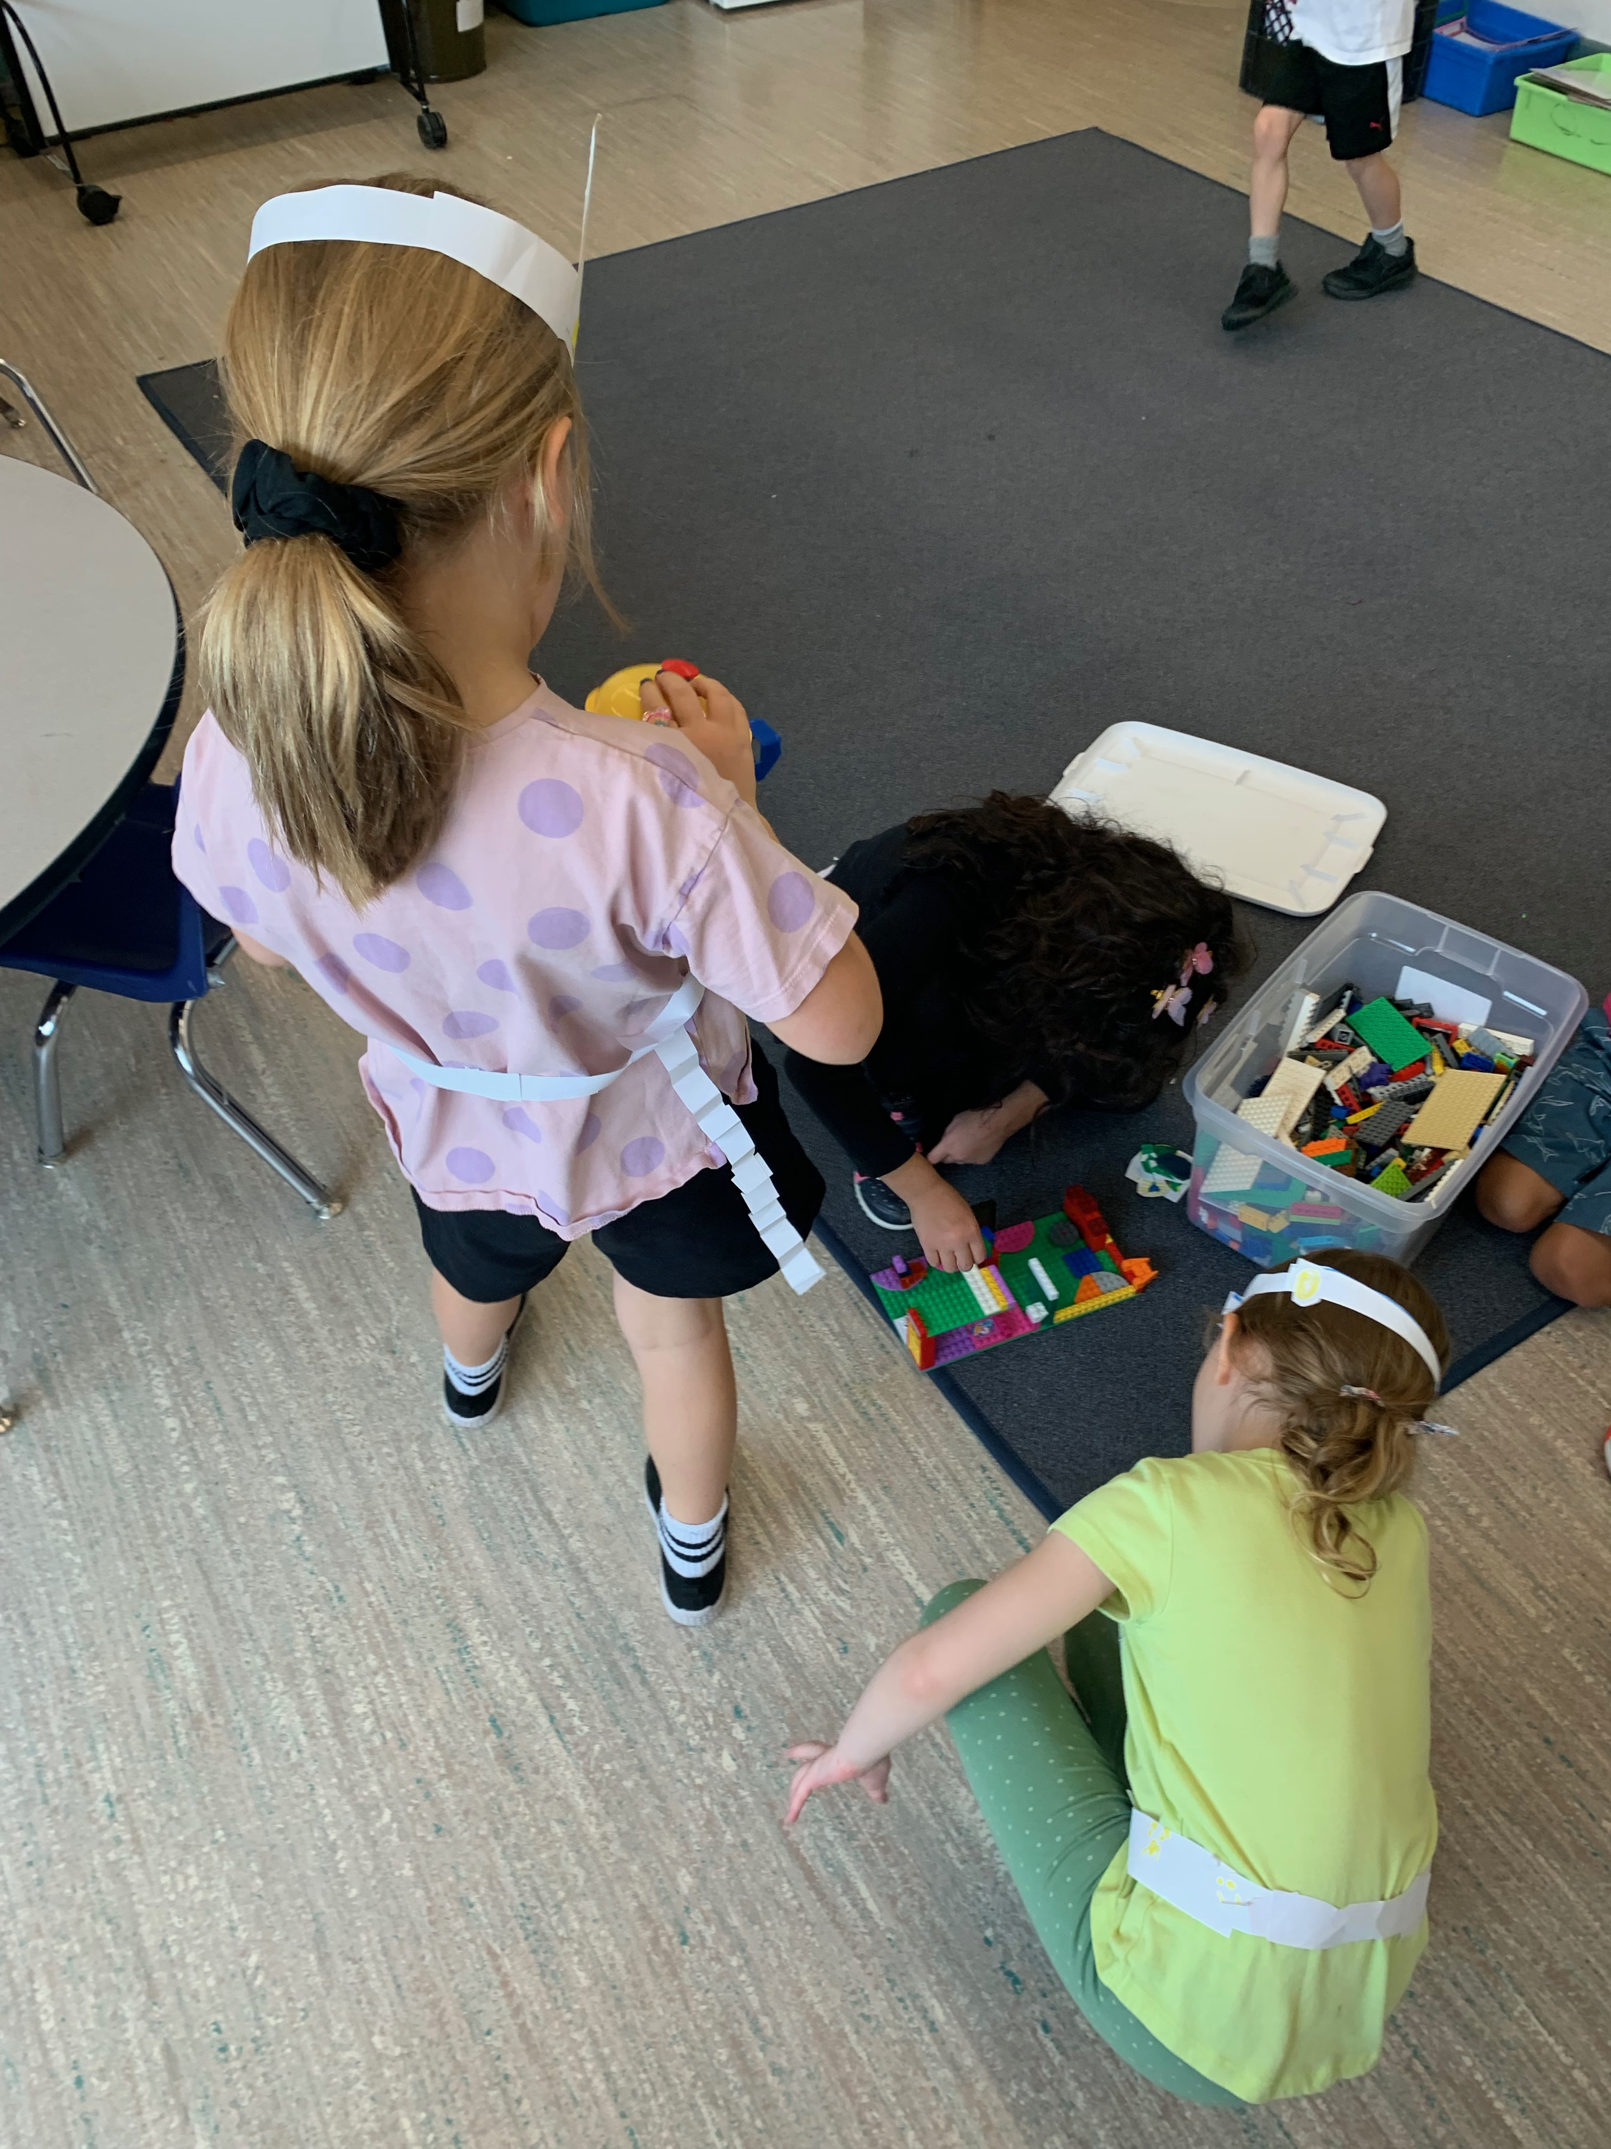
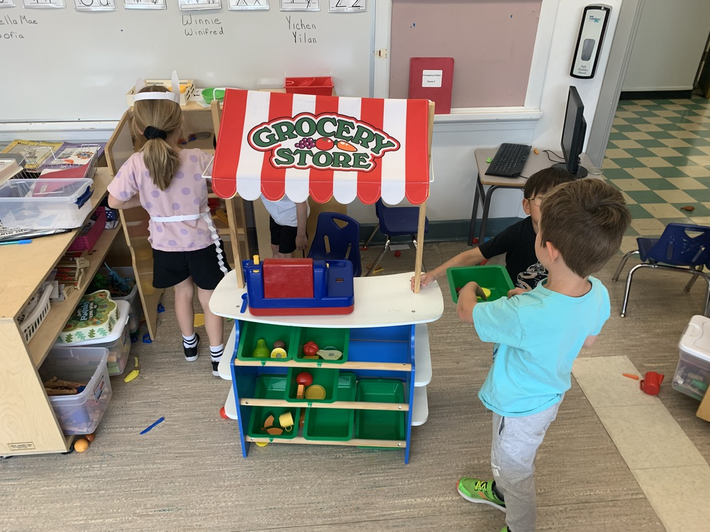
A glimpse inside the kindergarten classroom

Slide 6

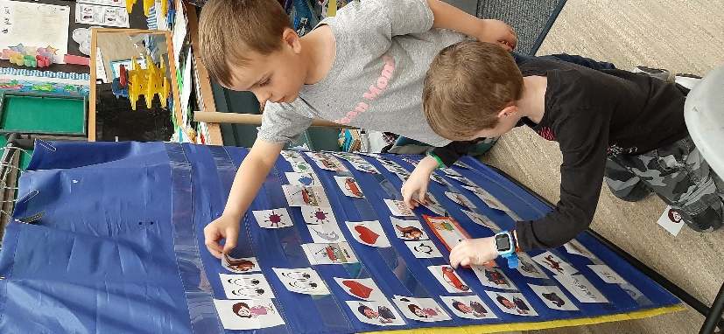
2025-26 School Hours – A Typical Day
Kindergarten
Monday - Thursday
Morning (A.M.): 8:00 a.m. - 10:53 a.m.
Afternoon (P.M.): 11:37 a.m. - 2:30 p.m.
Alternating Fridays:
8:00 a.m. – 12:00 noon (see calendar on our website)
Snack mid-morning and mid-afternoon
Grade 1
Monday - Thursday
8:00 a.m. - 11:40 a.m. and 12:18 p.m. - 2:30 p.m.
Fridays
8:00 a.m. – 12:00 p.m.
Lunch hour
Snack at recess
Gym
Outdoor time
Music
Notes:
Steph

Slide 7
First Day of School - Kindergarten
The first day of school for kindergarten will be:
A-L: Tuesday, September 2nd
Morning Kindergarten 8:00 a.m. - 9:50 a.m.
Afternoon Kindergarten 11:40 a.m. - 1:30 p.m.
M-Z: Wednesday, September 3rd
Morning Kindergarten 8:00 a.m. - 9:50 a.m.
Afternoon Kindergarten 11:40 a.m. - 1:30 p.m
Regular Friday hours will begin for kindergarten on Friday, September 5th (a.m. kindergarten that day).
Bussing is available as of September 2nd, 2025.
Notes:
Julie

Slide 8
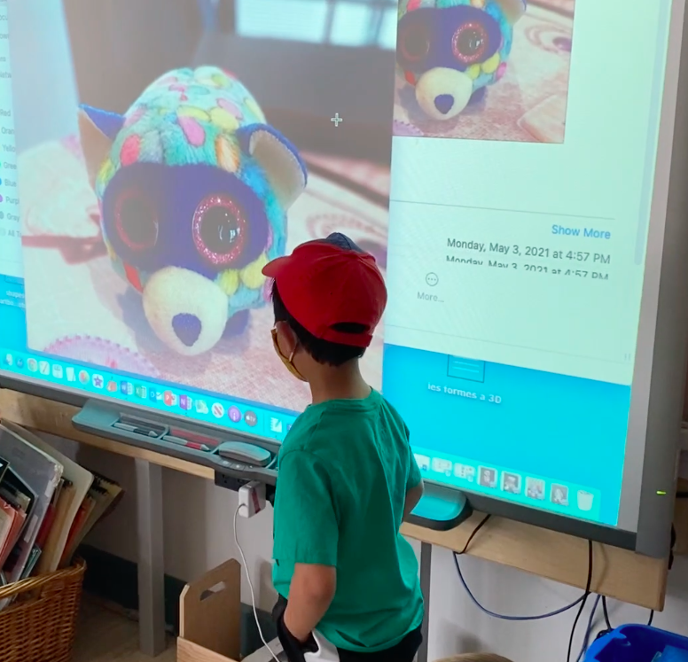
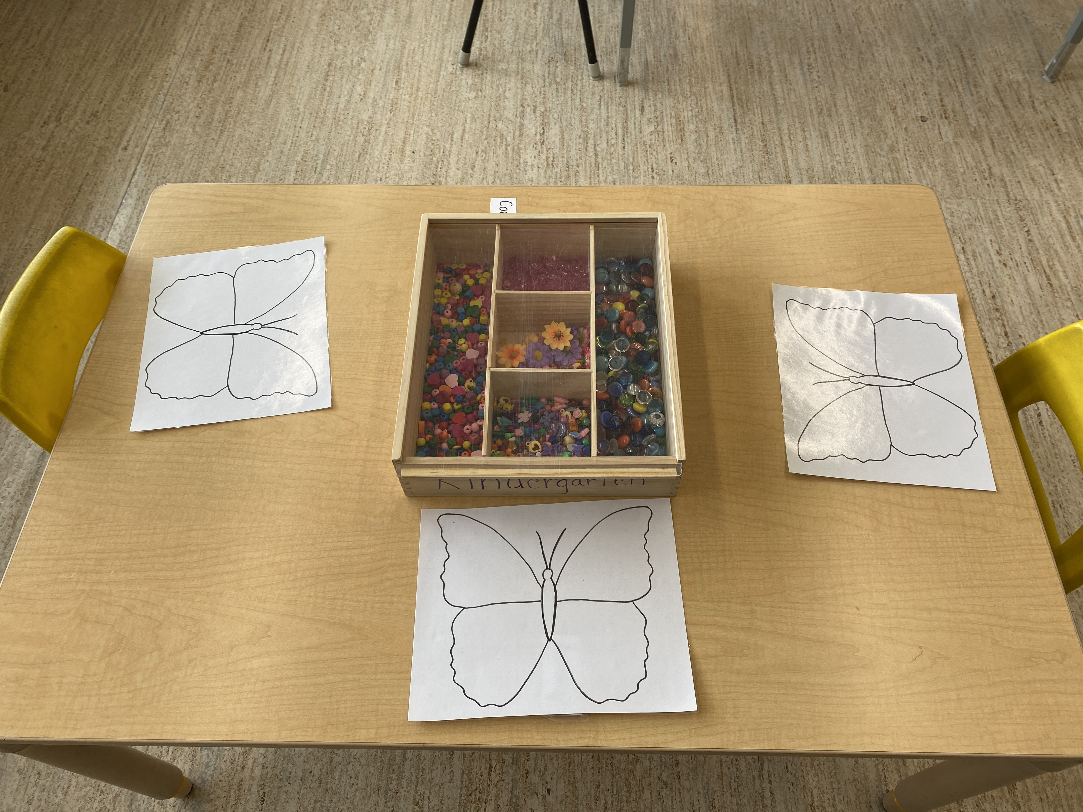
First Day of School – Grade 1
Regular bussing and regular hours will begin for Grade 1 on Tuesday, September 2nd.
If your child will be taking the bus, please have them start taking the bus that day.
It’s important that students learn bussing routines during the first week of school. This helps supervisors and their bus driver to get to know your child.
Notes:
Julie

Slide 9
Dismissal
Kindergarten students who take the bus are walked to the bus. Students who are picked up are released to an adult at the main doors.
Please email the teacher and cc the office (westgate@cbe.ab.ca) if there will be something different than the typical routine at dismissal.
Grade 1 students are walked to the bus by their teacher at the start of the year.
Notes:
Stephanie

Slide 10

Safety and Security
All parents must enter the school by the front door. We ask that parents not accompany their child to their coat hooks.
Sign in at the office and pick up a name tag (if you are volunteering).
Students who need to leave during the school day must be signed out at the office by a parent/guardian.
Students who arrive late must stop at the office for a late slip.
If your child will be absent or late, please inform the office prior to the class start time.
Notes:
Steph

Slide 11

Parking
The best place to park is on the south side of the schoolyard by the compound (10th Avenue SW).
8th avenue – can be used if you are only dropping off
Limited parking across the street from the school.
Both parking lots are for staff parking only.
Set an example! Be safe! Please do not park in the bus zones and use the crosswalks.
Be mindful we are in a residential area and don't block alleys or driveways.
Give yourself lots of time to arrive safely at school
Notes:
Julie

Slide 12
Transportation Fees
The proposed bussing fee for next year is $360/year ($180 for one-way Kindergarten transportation).
Pre-registration can be completed using your MyCBE account before Sunday, June 22nd. You will need your child’s CBE ID number to add your child to your account.
Registrations received after June 22nd will be added to closest existing spots with available space. Processing times could be up to six weeks at the beginning of the school year.
If you are not sure if you require transportation, please still register. You can cancel with no penalty by September 30, 2025 and fees can be paid monthly.
Waivers are available. If you feel you may not be able to pay the fees, please complete a waiver form on you MyCBE account.
Notes:
Stephanie

Slide 13

Bus Schedules and Maps
Bus stops will be created using your home address.
Bus schedules will be available on your CBE Account mid August 2025.
There is no mid-day bussing for kindergarten.
We require your child’s bus route letter prior to them taking the bus. Please watch for an email at the end of August requesting this information. It is very important to reply promptly.
Notes:
Stephanie

Slide 14
Bus Safety
The safety of our children on the bus is very important to us.
Please arrive at your child’s bus stop 5 minutes prior to drop off time.
Kindergarten and Grade 1 students will not be dropped off if the adult that normally picks them up is not at the bus stop. If no one is there, the bus driver will return the child to the school.
Kindergarten students are escorted from the bus to their meeting place when they arrive and from the school to the bus at the end of the day.
Bus delays are posted on www.myschoolbusmonitor.ca and through Southland's MyBusStop App each shift as early as possible. You can sign up for push email notifications on www.myschoolbusmonitor.ca or refer to the website and app.
Notes:
Stephanie

Slide 15

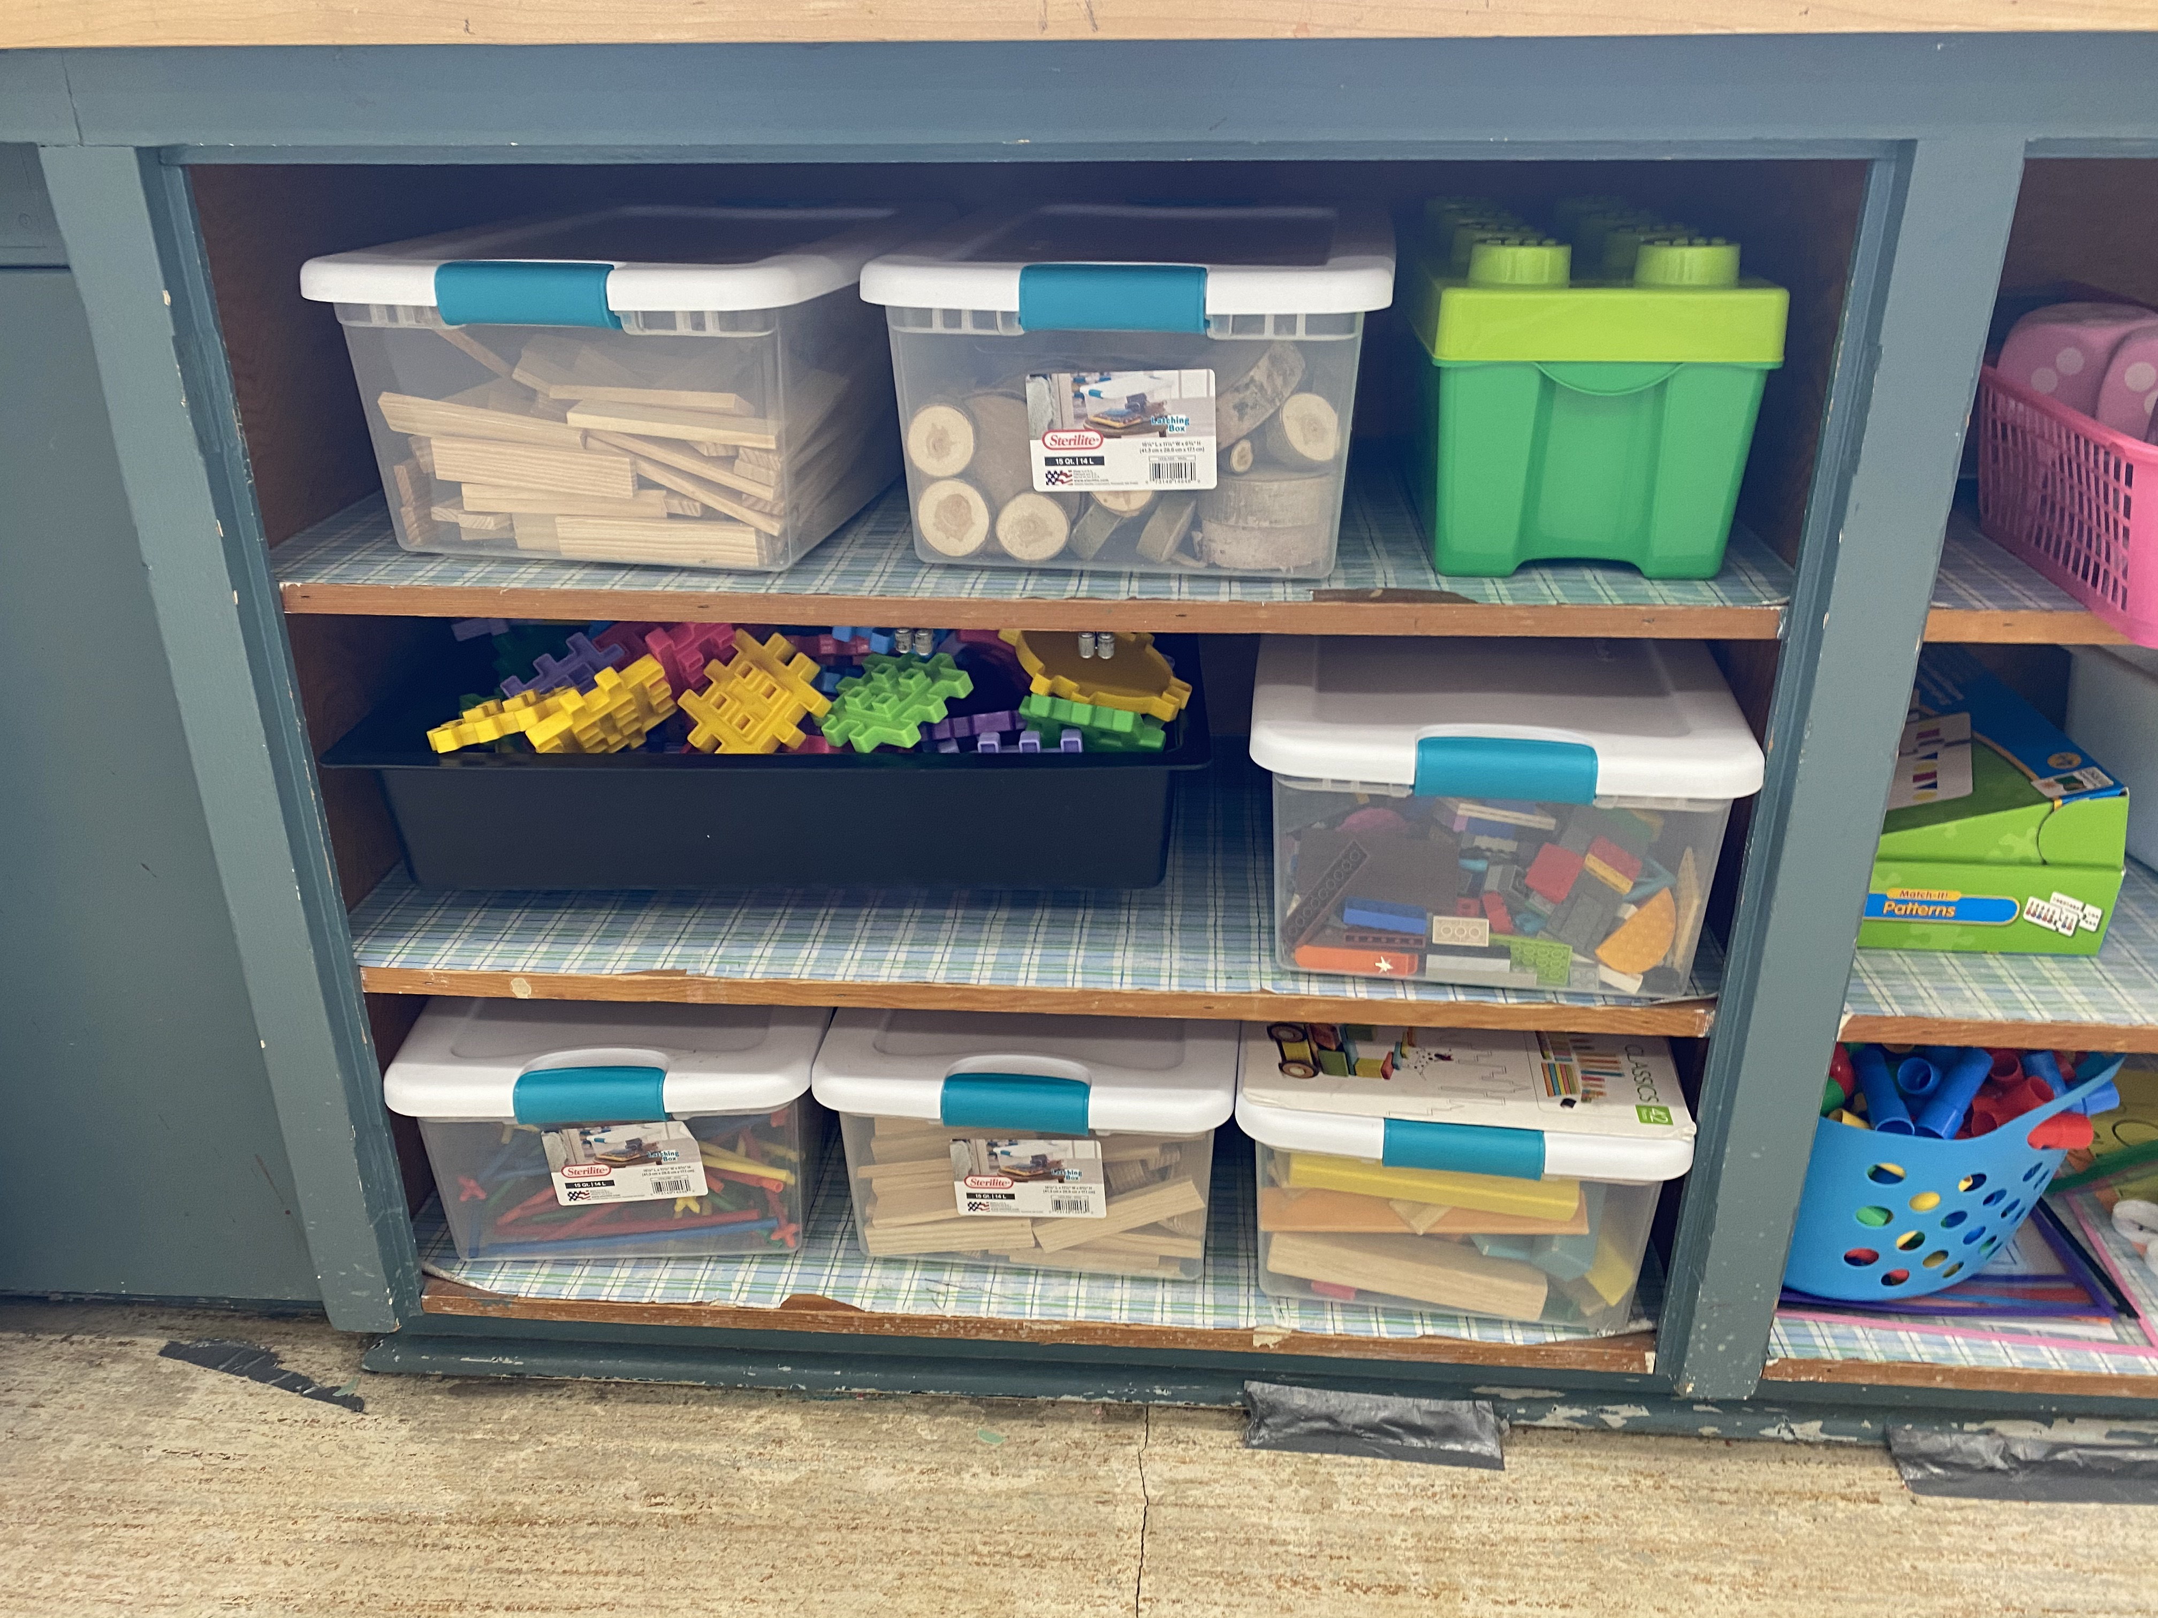
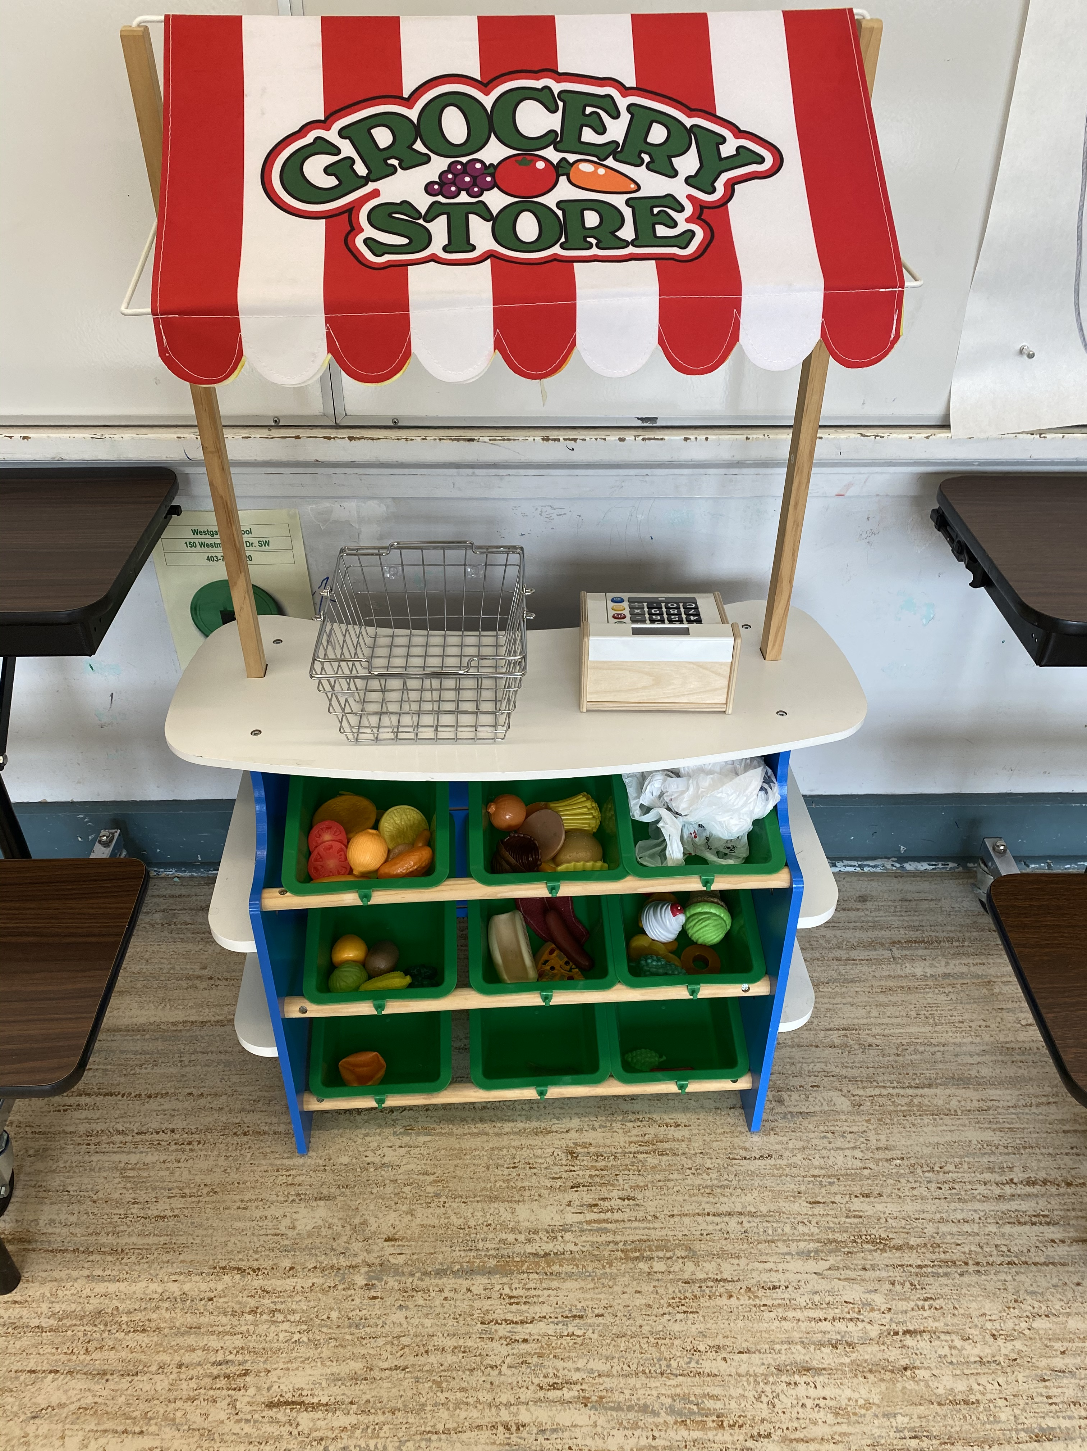
Kindergarten School Supplies/Fees
Information about fees will be communicated at a later date.
Students will need a backpack, water bottle, indoor shoes (please no laces unless your child can do up their own laces) and a small, nutritious snack that they can open.
Notes:
Julie

Slide 16

Email Messages
Due to Canada’s Anti-Spam Legislation (CASL), you need to subscribe online if you want to receive email or text messages on “commercial” school topics such as picture days, student fees, field trip costs, yearbooks, fun lunches and more.
If you do not subscribe, you will not receive these messages but you will receive emails on non-commercial topics such as emergency notifications.
Subscription applies indefinitely (unless withdrawn) for all your children at all CBE schools, so long as your email address stays the same. If your email changes, please contact the school to update your email address and then subscribe with the new email.
Subscribe right now at: http://calgary.schoolmessenger.com/cbe_subscribe
Notes:
Julie IN ORDER TO RECEIVE COMMERCIAL EMAILS YOU MUST SUBSCRIBE – PLEASE TAKE OUT YOUR CELL PHONES AND GO TO WWW.CBE.AB.CA/SUBSCRIBE

Slide 17
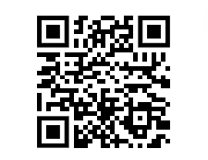
SUBSCRIBE TO STAY INFORMED

Slide 18
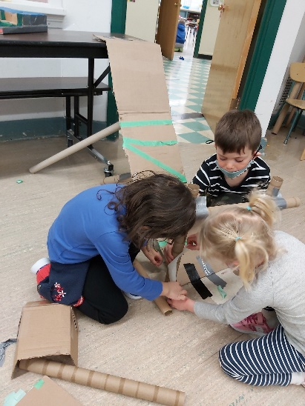
Communication
We believe communication between the school and home is essential.
Methods of communication will vary including: personal contact, backpack mail, email, and phone calls.
If you have a concern related to a classroom issue, the proper protocol is to bring it up with the teacher, and then with administration if it has not been resolved.
For a school-wide issue it is appropriate to bring it to administration right away.
Notes:
Julie

Slide 19

Volunteering in the classroom
Our volunteer program usually begins in October. It is important to complete a police information check early! Forms and information regarding volunteering will be sent home in September.
We will ensure there is a fair rotation of volunteers, so all who wish to do so, will have the opportunity to help along the way.
According to CBE Policy siblings are not able to accompany their parents when they volunteer.
Notes:
Stephanie

Slide 20
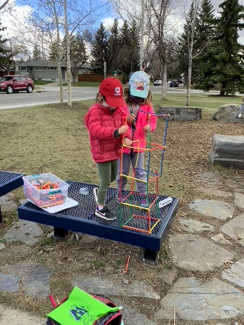
CBE Volunteer Registration and Police Clearances
All volunteers must obtain a CBE security clearance from the Calgary Police Service. Police clearances are valid for 5 years.
The first step of the process must be done through SchoolEngage and the second part on-line
You must have government issued photo ID to apply for a police check.
You must have lived in Canada for at least 1 year before you can apply and you must also have a current Calgary address.
Notes:
Julie - Can tell parents that Donita and Dana are in the office tonight to start the process. They must have one government issued photo ID with them.

Slide 21
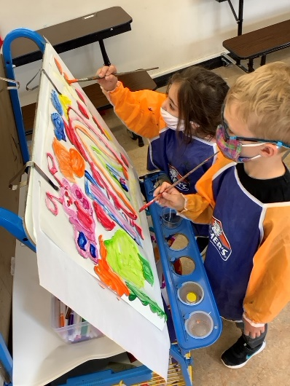
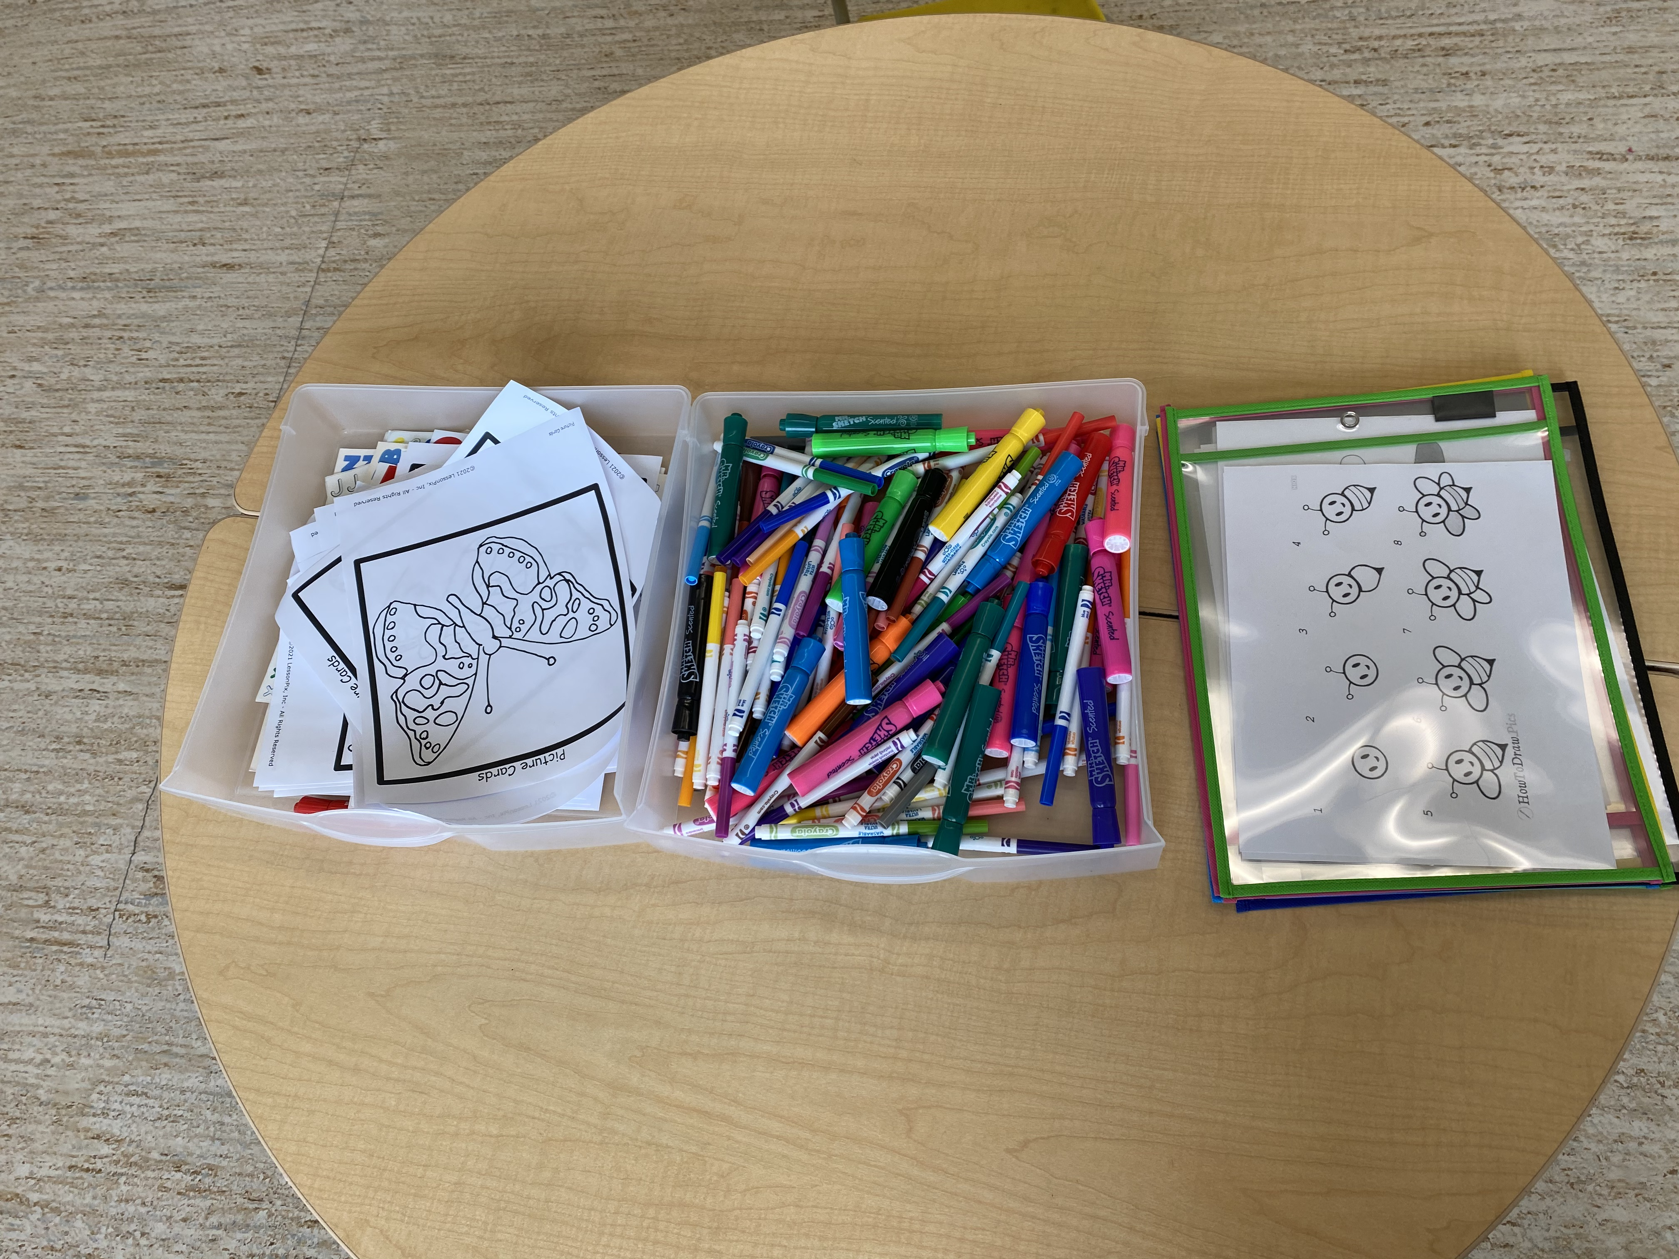
Kindergarten 2025-26
Based on current registrations, we anticipate that we will have four Kindergarten classes (2 AM and 2 PM) and four Grade 1 classes.
We held a draw to balance class sizes between morning and afternoon Kindergarten classes.
Should your plans to attend Westgate School change please notify our office as soon as possible.
Notes:
Julie

Slide 22
Childcare
A list of childcare providers in the area:
Child’s Play: (403) 919-5118
Summitt Kids: (403) 477-4346
Kell's Kids: (587) 583-1977
Kids & Company: (403) 237-5437
KidZinc: (403) 240-2059
My 2nd Home: (403) 874-6273
Alpine Montessori: (403) 249-9474
Clever Daycare: (403) 474-4157
We cannot endorse any particular caregiver
Calgary Child’s Play will be leasing space in our school
Notes:
Julie

Slide 23

Westgate School Council
Westgate School Council performs an important advisory role at the school:
Sharing information with parents
Ensuring parent perspective is considered in decision making
Supporting education and student enrichment opportunities
Fostering school spirit through assisting with community building
Organizing family centered social events
Supporting student health and wellness and language learning
Some other things we support in the school include:
Special lunches, Gatorfest, grounds work, environment,
science and language special focus groups, Christmas community support, parent education events, farewell committee and many more!
To be in touch contact us via email: westgateschoolcouncil@gmail.com
Chair: Stephanie Paquet
Notes:
Marie-Claude

Slide 24
Who and When
As a Westgate parent you are automatically a member of School Council, you are welcome at all meetings.
There are also ways to be even more involved, on a committee or on the executive.
Meeting dates are the last Thursday in September, October, November, January, February, April and May.
School Council has hosted parent engagement nights during the school year.
To be in touch with the School Council, contact us via email: westgateschoolcouncil@gmail.com
Chair: Stephanie Paquet

Slide 25

École Westgate Parents’ Society
The society exists mostly for the purpose of fundraising and offering financial support for enrichment opportunities, teaching supplies and more at the school.
We do a few large fundraisers throughout the year:
Read-a-thon
Gatorfest at the end of May
Casino
Plus, we also usually do other smaller scale fundraisers for special projects each year.
As a parent, you are automatically a member of the Parents’ Society
We would love you to be involved in the work we do!
The society meeting is held right after the council meetings every month!
To be in touch contact us via email: westgateschoolcouncil@gmail.com
Chair: Stephanie Paquet

Slide 26
For More Information
Our school website provides parents with important information regarding school policies, upcoming activities and events http://school.cbe.ab.ca/school/westgate/Pages/default.aspx.
Kindergarten / Grade 1 information can be found on our website at Teaching and Learning>Kindergarten
Any important website for information about the Calgary Board of Education is www.cbe.ab.ca.
The school office will open on Wednesday, August 27th. The phone number is 403-777-8420.
You may also email us at westgate@cbe.ab.ca
Stephanie Leech – Assistant Principal – saleech@cbe.ab.ca
Julie Muhlberger – Principal – jamuhlberger@cbe.ab.ca

Slide 27
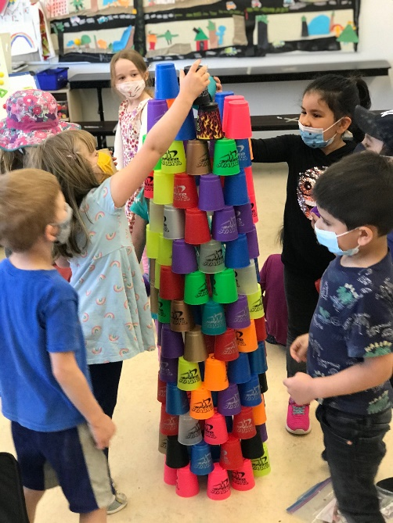
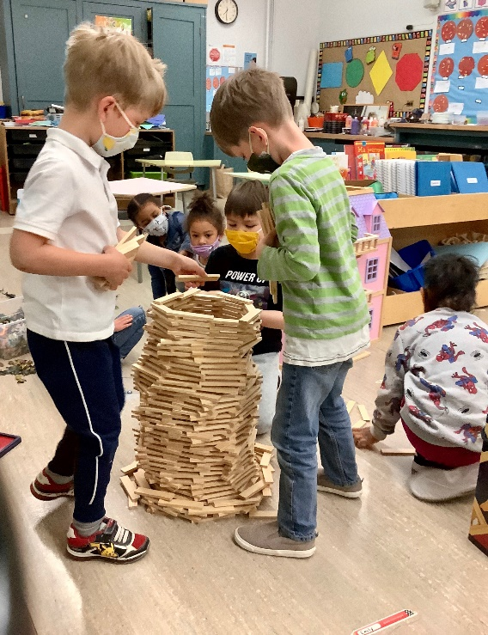
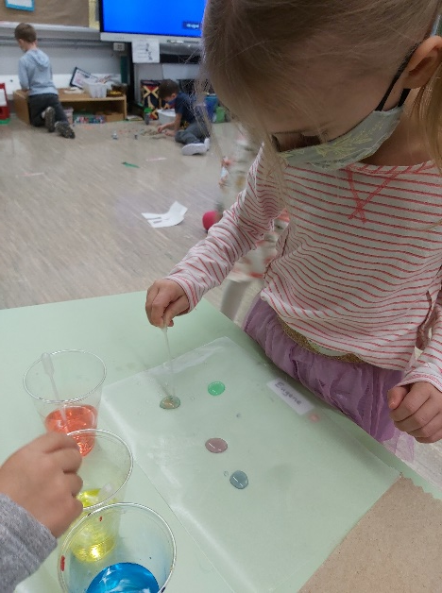
Questions? Now better than during tour!

